Slide 1


SOFTWARE ENGINEERING (Week-8)
Usama Musharaf
Lecturer (Department of Computer Science)
FAST-NUCES Peshawar

Slide 2
Contents of week # 8
Software Quality Attributes
Reliability
Application Architecture to System Architecture

Slide 3
Reliability

Slide 4
Reliability
Software reliability is defined as the probability of failure-free operation of a software system for a specified time in a specified environment.

Slide 5
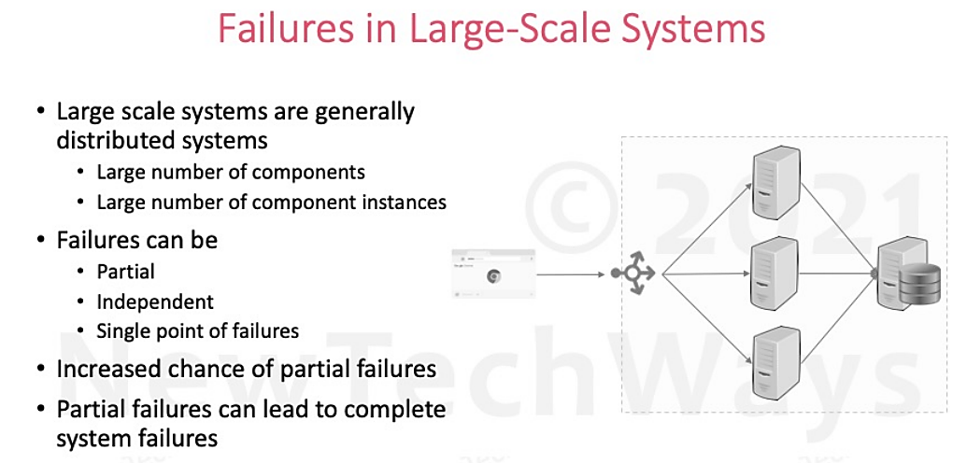

Slide 6
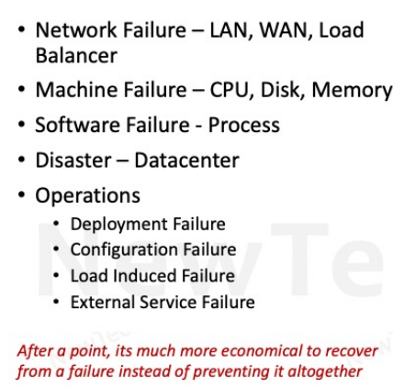
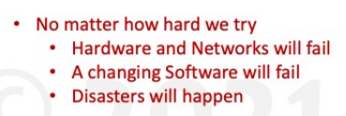
Partial Failures

Slide 7
Reliability Engineering
Reliability
Availability
Fault Tolerance

Slide 8
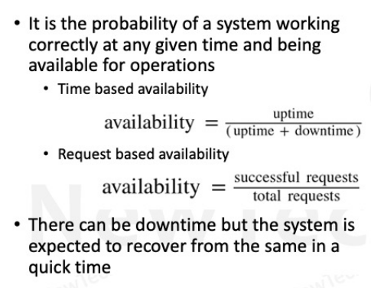
Availability

Slide 9
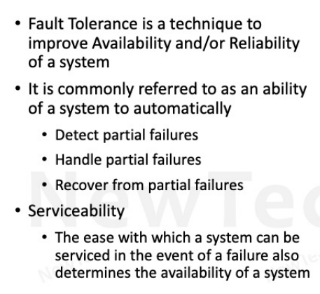
Fault Tolerance

Slide 10
Fault Tolerant Design
Redundancy
Fault Detection
Recovery

Slide 11
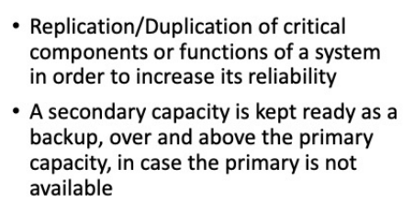
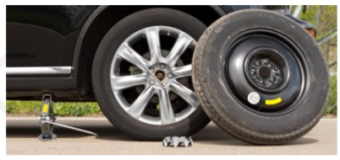
Redundancy

Slide 12
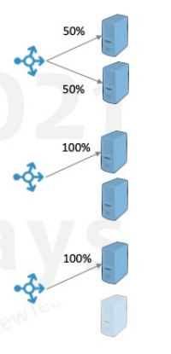

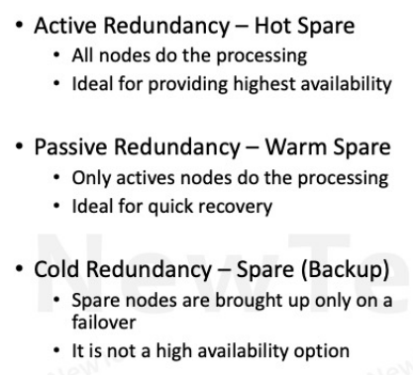
Types of Redundancy

Slide 13
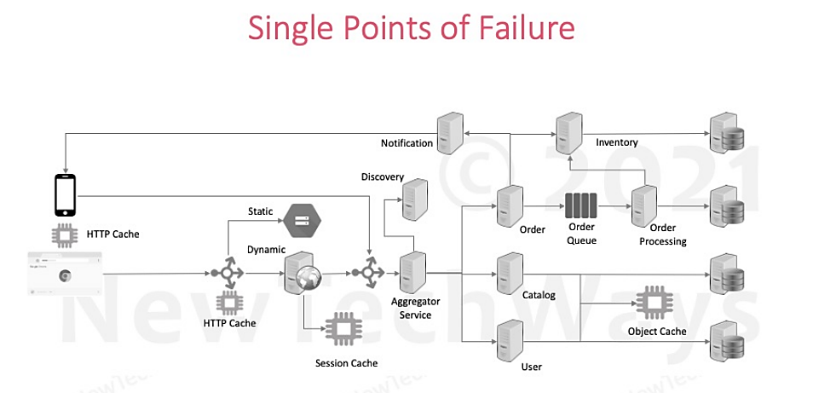

Slide 14
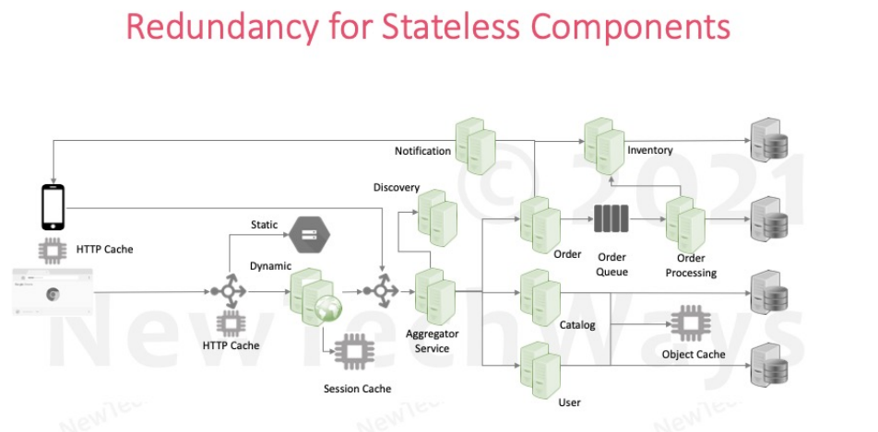

Slide 15
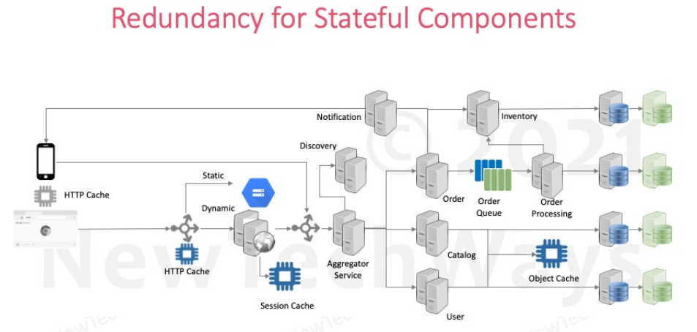

Slide 16
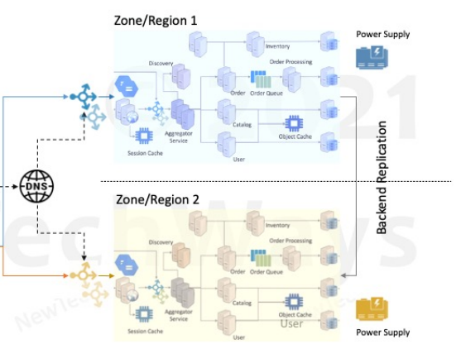
Datacenter Redundancy

Slide 17
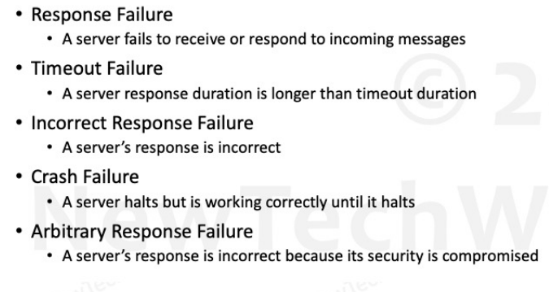
Fault Models

Slide 18
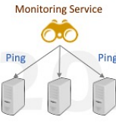
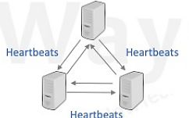
Health Checks
External Monitoring Service
Ping based
Internal Cluster Monitoring
Heartbeat based

Slide 19
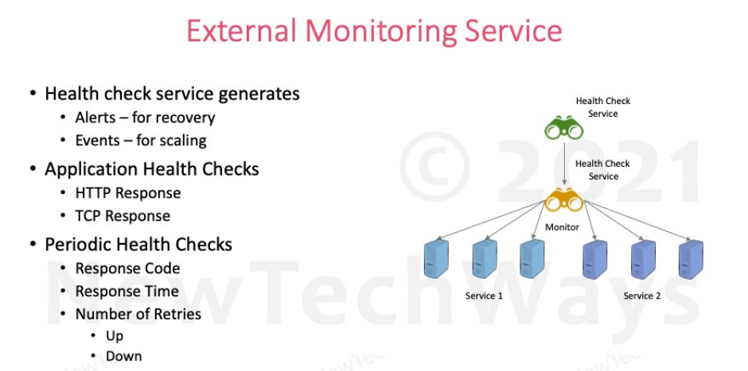

Slide 20
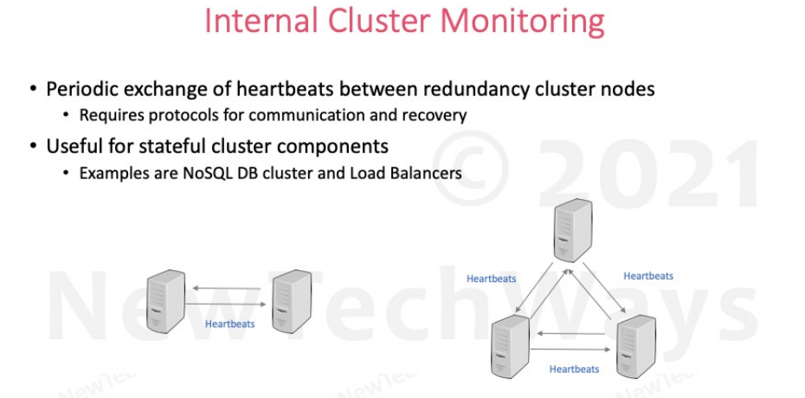

Slide 21
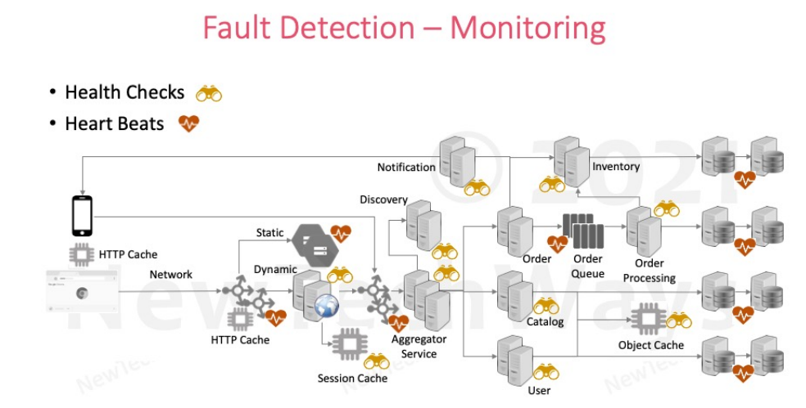

Slide 22
Application Architecture

Slide 23
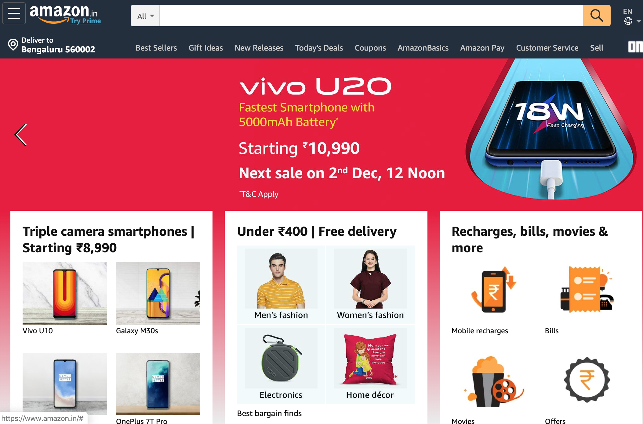
Assume ‘Architecting’ a big e-commerce system

Slide 24
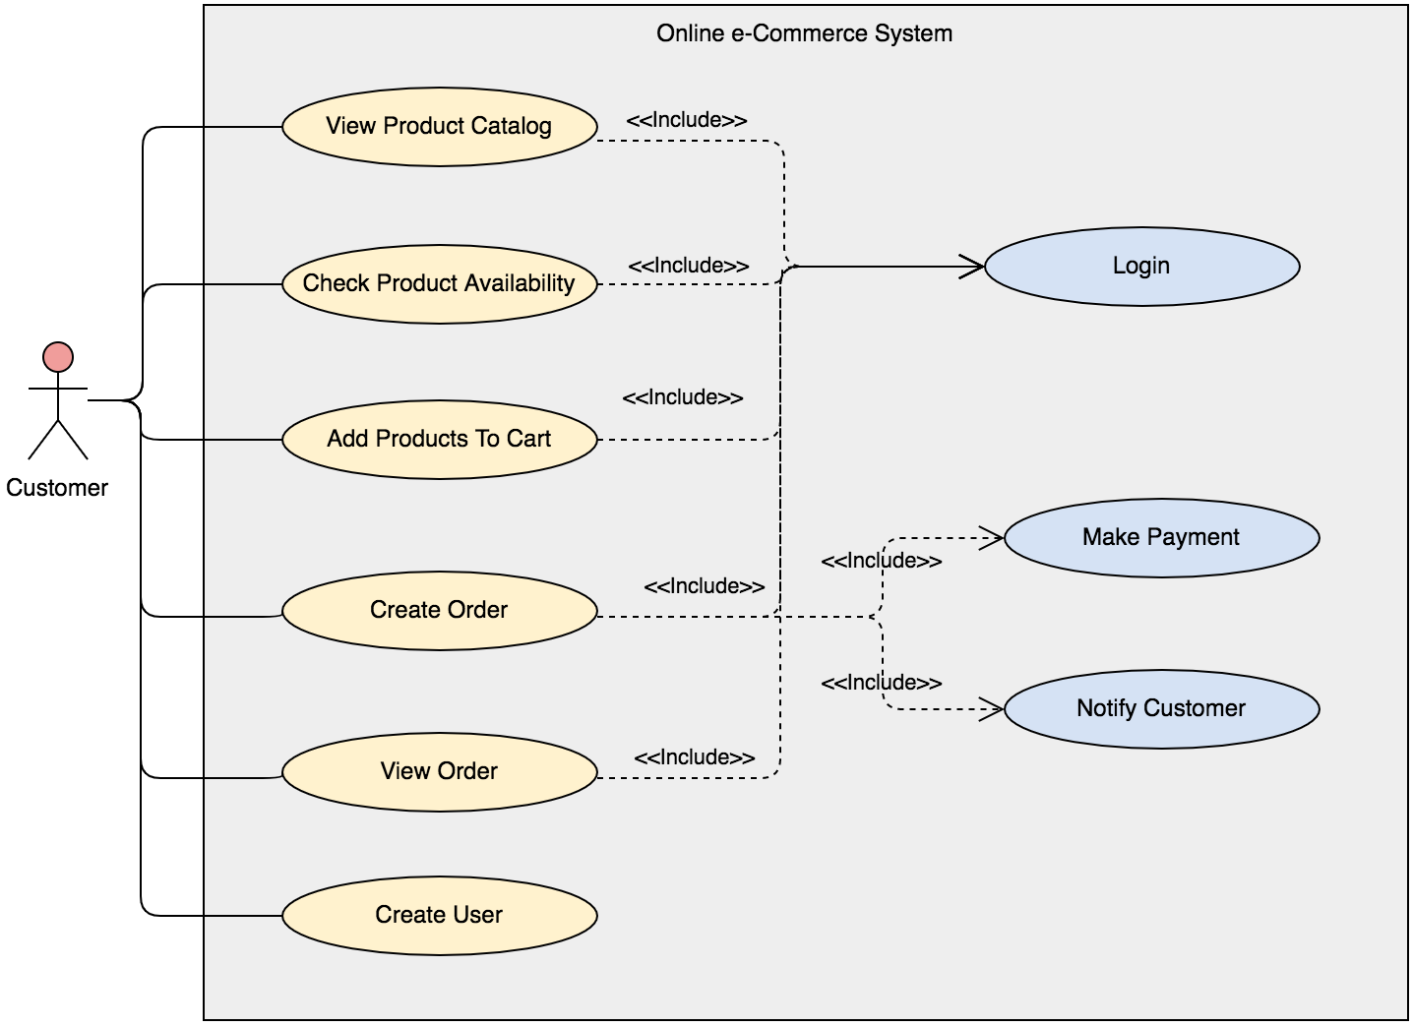
Use Case Model
NewTechWays

Slide 25
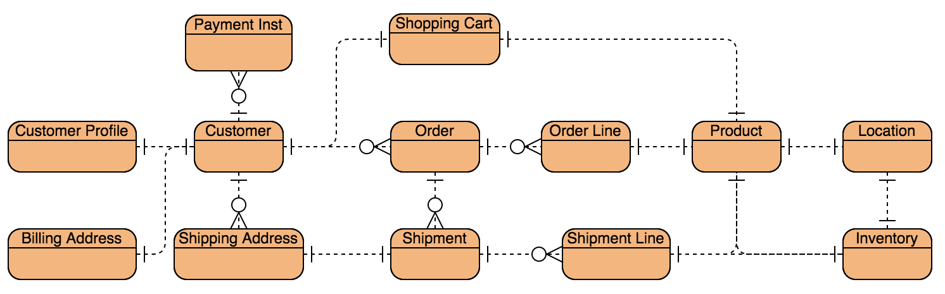
Domain Model
NewTechWays
NewTechWays

Slide 26
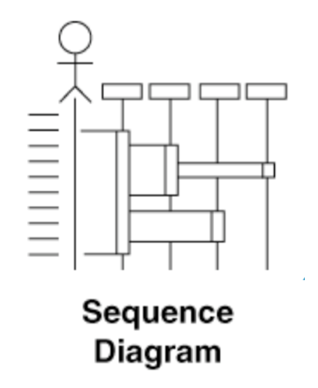
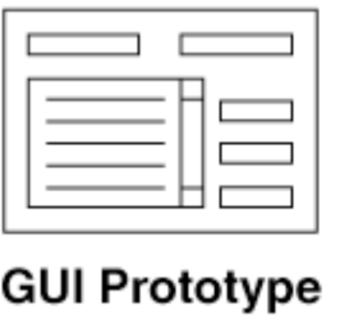
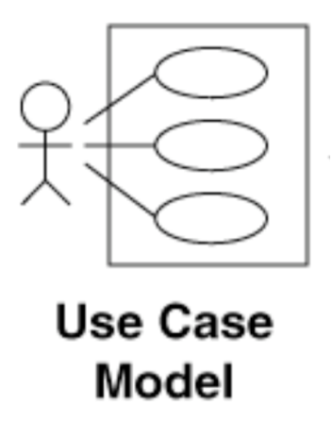
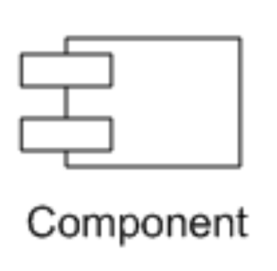
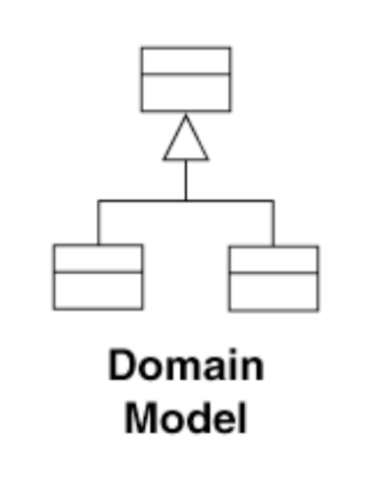
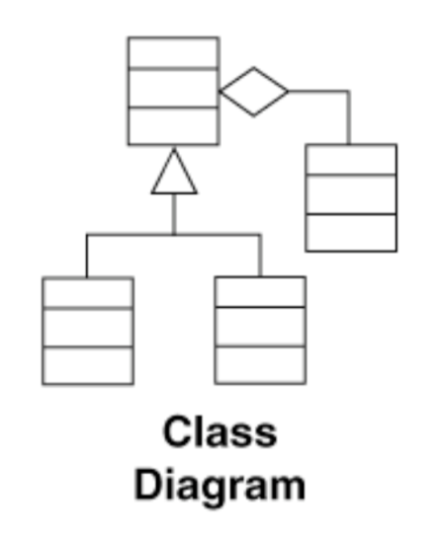
Low Level Design
Behavior
State
Code
Static + Transactional

Slide 27
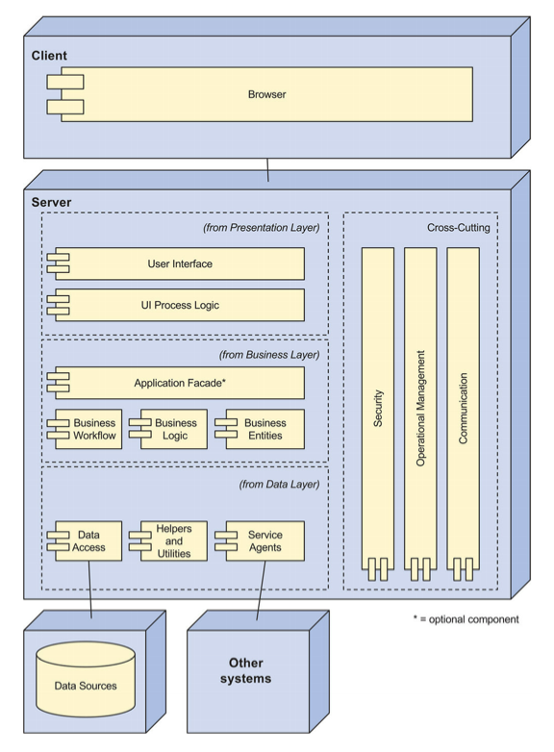

Component Model
Client
Web
Tier
Business Logic
Tier
Database

Slide 28
What About?
High
Availability
Response
Latency
Global
Customers
System &
Data Security
File storage for
Catalog Images
Mobile
Support
Unstructured Data
Storage & Analytics
Cloud
Deployment

Slide 29

Going Beyond
Application Architecture To System Architecture

Slide 30
Application Architecture Vs System Architecture
System level challenges
surface up in large scale systems
Scale, Reliability, Security, Deployment are biggest concerns for a large-scale system

Slide 31
Latency Requirements
10 years ago, Amazon found that every 100ms of latency cost them 1% in sales
Now Akamai study shows that every 100-millisecond delay in website load time can hurt sales by 6%
Google found an extra .5 seconds in search page generation time dropped traffic by 20%
Notes:
https://www.thinkwithgoogle.com/marketing-resources/data-measurement/mobile-page-speed-new-industry-benchmarks/
https://www.gigaspaces.com/blog/amazon-found-every-100ms-of-latency-cost-them-1-in-sales/

Slide 32
Scalability Requirements
10 million requests/day
1K to 100K simultaneous users
100 million products
Transaction data for last 5 years
Petabytes of log data
For 100 M products with average product description/image size of 1 MB
Data Storage = 100M x 1MB = 100 TB
Logs generated and archived
Data Storage => in Petabytes

Slide 33

Availability & Reliability Requirements
Unavailability results in
Business loss
Reputation loss
99.95% Availability
Maximum cumulative disruption of 4 hours 22 minutes in a year
99.999999999% Durability for storage systems
Data once stored is practically never lost
Disaster Recovery
Operations to continue even if a region goes down due to a natural calamity

Slide 34
Security Requirements
Infrastructure protection
Network access
System access
Service access
Data Protection
Data sensitivity classification
Protect data at rest
Protect data on wire
Data backup & replication
Identity & Access Management
Authentication, Authorization

Slide 35
Designing System Architecture

Slide 36
Scalability Principle
Monolith is an anti-pattern for Scalability
Scalability goes up with
Decentralization
More specialized workers – Services
More workers – Instances, Processors, Threads
Independence
Multiple workers are as good as a single worker if they can’t work independently
They must work concurrently to maximum extent

Slide 37
Modularity
Scalable architecture starts with modularity
Provides the foundation for breaking a system function/service into more specialized functions/services
Web Browser
Web Application
Business Application
DBMS
View
API Protocol Layer
Controller
Service Modules:
User
Catalog
Order
Inventory
Model
Data Access Layer

Slide 38
Specialized Services – WebServices
Services can be scaled differently e.g., Number of instances
Notification Service
Inventory Service
Order Service
Web Application
Catalog Service
User Service

Slide 39
Aggregator Service & RESTful API – Mobile Support
REST for external interface interoperability & Mobile Support
Notification Service
Inventory Service
Order Service
Web Application
REST
Catalog Service
RESTful
Aggregator/
Gateway
Service
User Service

Slide 40
Independent Services – MicroServices
Micro-Services can be scaled differently and deployed independently
Notification Service
Inventory Service
Order Service
Web Application
Catalog Service
Aggregator/
Gateway
Service
User Service

Slide 41
Asynchronous Services
Updates can be done asynchronously to buffer peak loads and to reduce response latency
Notification
Inventory
View Order
Create/Update Order
Web Application
Order
Queue
Order
Order
Processing
Catalog
Aggregator/
Gateway
Service
User

Slide 42
Stateless Replication
Replication provides more computation power
Notification
Inventory
Web Application
Order
Queue
Order
Order Processing
Catalog
Aggregator/
Gateway
Service
User

Slide 43
Reliability Principle
Reliability and Availability are achieved mainly through Fault Tolerance
Fault Tolerance requires
Provisioning Redundancy
Fault Detection Mechanisms
Health-checks, heart-beats
Reliability
Normal functioning even in the presence of faults
Availability
Always available even in the presence of faults

Slide 44
Single Point Of Failures
Identify all SPOF
Any component that does not have a redundant replica is a SPOF
Power Supply
Notification
Inventory
Discovery
Static
HTTP Cache
Order
Order
Queue
Order
Processing
Dynamic
Catalog
HTTP Cache
Aggregator
Service
Object Cache
CDN
Session Cache
User

Slide 45
Redundancy
Components that are SPOF requires redundancy
Power Supply
Notification
Inventory
Discovery
Static
HTTP Cache
Order
Order
Queue
Order
Processing
Network
Dynamic
Catalog
HTTP Cache
Aggregator
Service
Object Cache
CDN
Session Cache
User

Slide 46
Monitoring For Fault Detection
Hierarchical Monitoring -> Health Checks
Peer to Peer Monitoring -> Heart Beats
Power Supply
Notification
Inventory
Discovery
Static
HTTP Cache
Order
Order
Queue
Order
Processing
Network
Dynamic
Catalog
HTTP Cache
Aggregator
Service
Object Cache
CDN
Session Cache
User

Slide 47
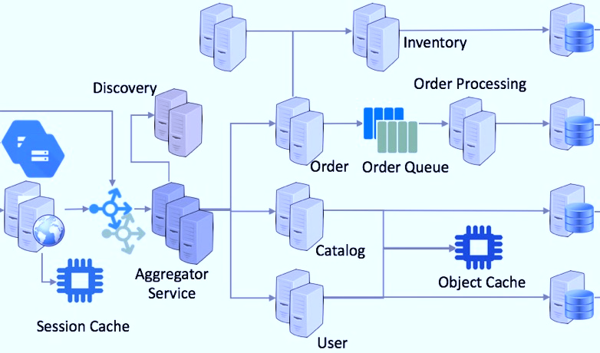


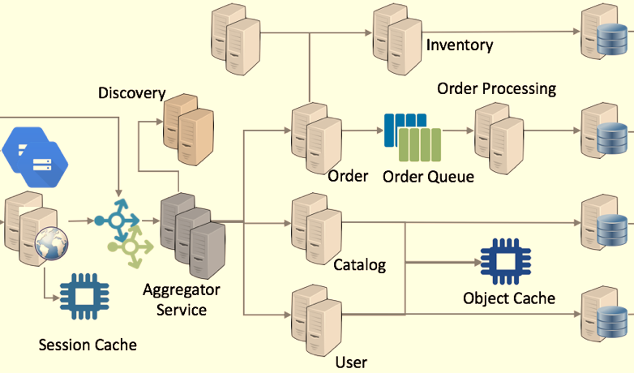

Zonal Redundancy
Zonal redundancy for fault isolation
Power Supply
HTTP Cache
Zone 1
NewTechWays
Backend Replication
Zone 2
HTTP
Cache
Power Supply
CDN
User

Slide 48
Security-Web Application Firewalls
Multiple security related attacks can be prevented by inspecting requests for common attacks and vulnerabilities by using Web Application Firewalls
Notification
TLS
Injection Attack
DDoS Attack
Session Hijacking
Web Application
Order
TLS
Catalog
Aggregator/
Gateway
Service
User Auth

Slide 49
HAVE A GOOD DAY!

